Slide 1
THE FUTURE OF THE KANKAKEE RIVER BASIN
Scott D. Pelath
Executive Director
Kankakee River Basin and Yellow River Basin Development Commission

Slide 2
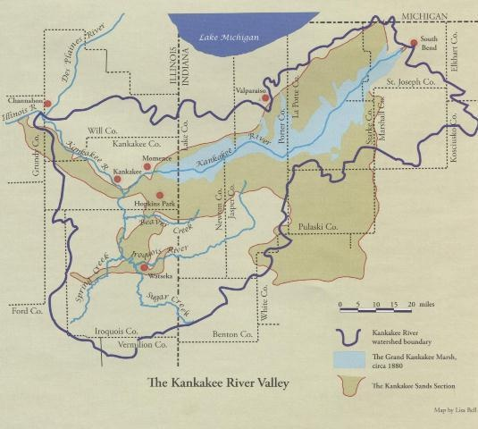
KANKAKEE RIVER BASIN

Slide 3
KANKAKEE RIVER BASIN PROFILE
Kankakee River extends 133 miles from St. Joseph County to Illinois River
Yellow River originating in St. Joseph County is the major Indiana tributary
In Indiana alone, the basin covers about 1.3 million acres, of which 1.1 million acres produce crops.

Slide 4
“Everglades of the North”
The Kankakee River Basin once was home to the second-largest freshwater marsh in the United States.

Slide 5
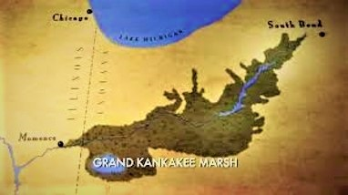
GRAND KANKAKEE MARSH

Slide 6
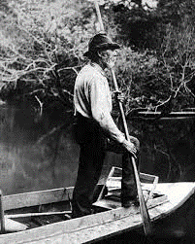
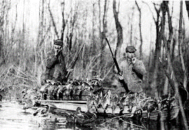
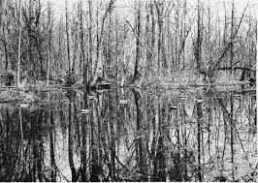
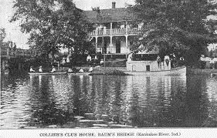
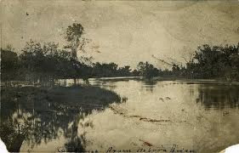
Grand Kankakee Marsh

Slide 7
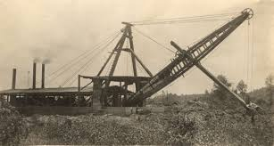
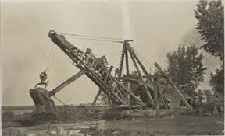
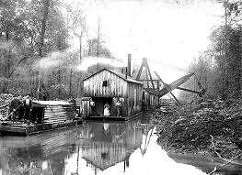
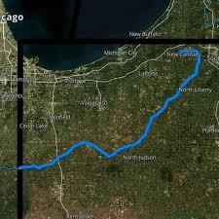
Drainage Completed during World War I

Slide 8
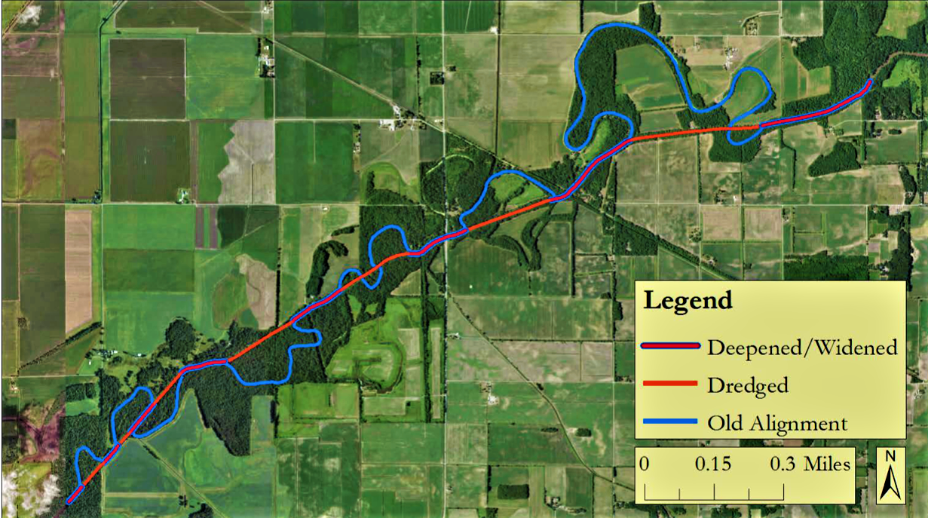
CHANNEL DREDGED AND MEANDERS CUT

Slide 9
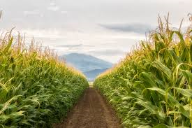
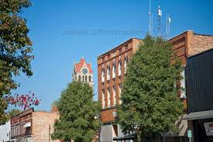

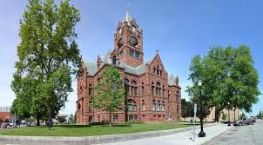
Outcomes and Consequences Remain with Us
Some of world’s most productive farmland
Communities grew and prospered on drier land
Land generates wealth for local, regional, and state economies
Taxes generated support schools, roads, and public services

Slide 10
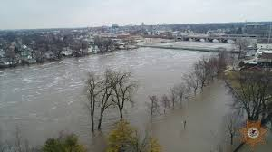
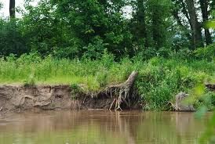
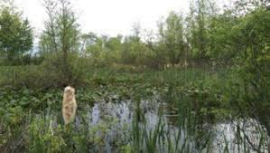
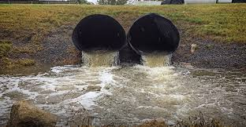
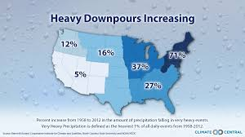
Outcomes and Consequences Remain with Us
Drained areas continue to flood and hold water
Relentless sediment and erosion clogs channels
Basin tends to revert to original state
Human activity coupled with increased precipitation quickly adds water to system

Slide 11
FLOOD OF FEBRUARY 2018
All-time record water levels at two points along Kankakee River
Water persisted in some areas for six weeks
Costly damage to private property and public infrastructure
Expensive allocations of resources for flood response and clean-up

Slide 12
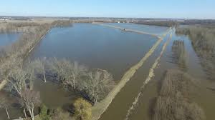
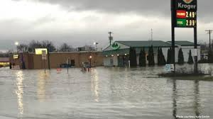
FLOOD IMAGES (2018)

Slide 13
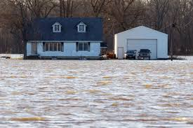
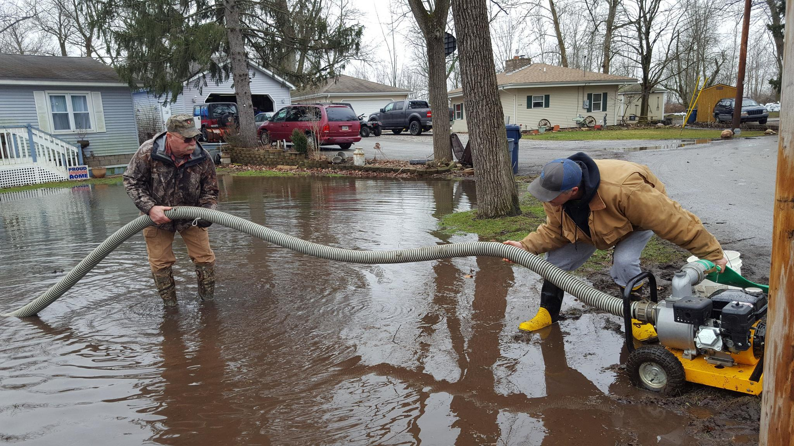
FLOOD IMAGES (2018)

Slide 14
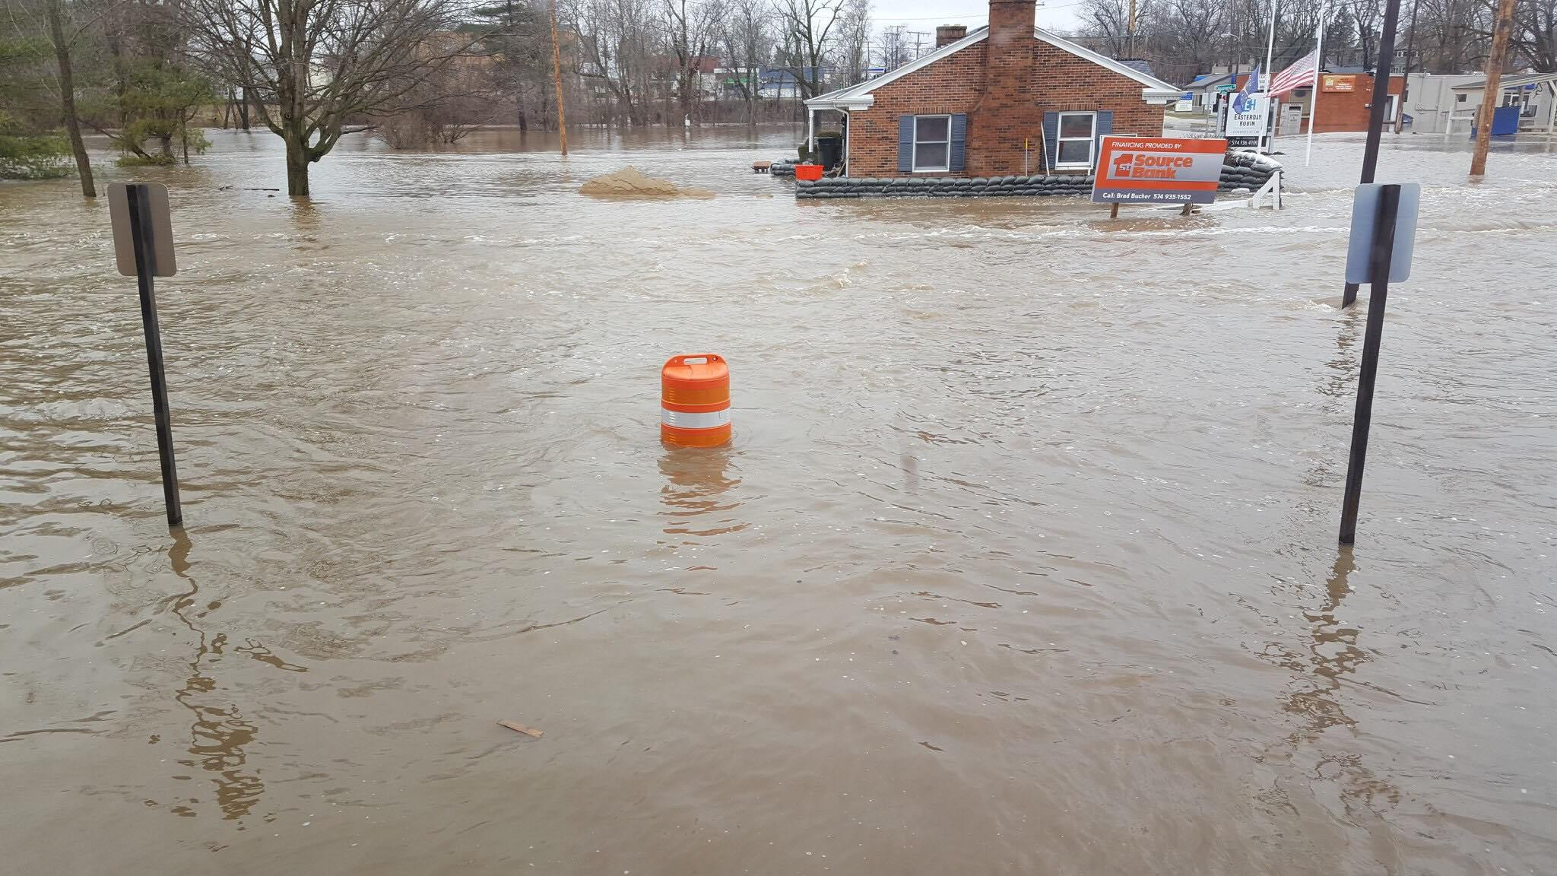
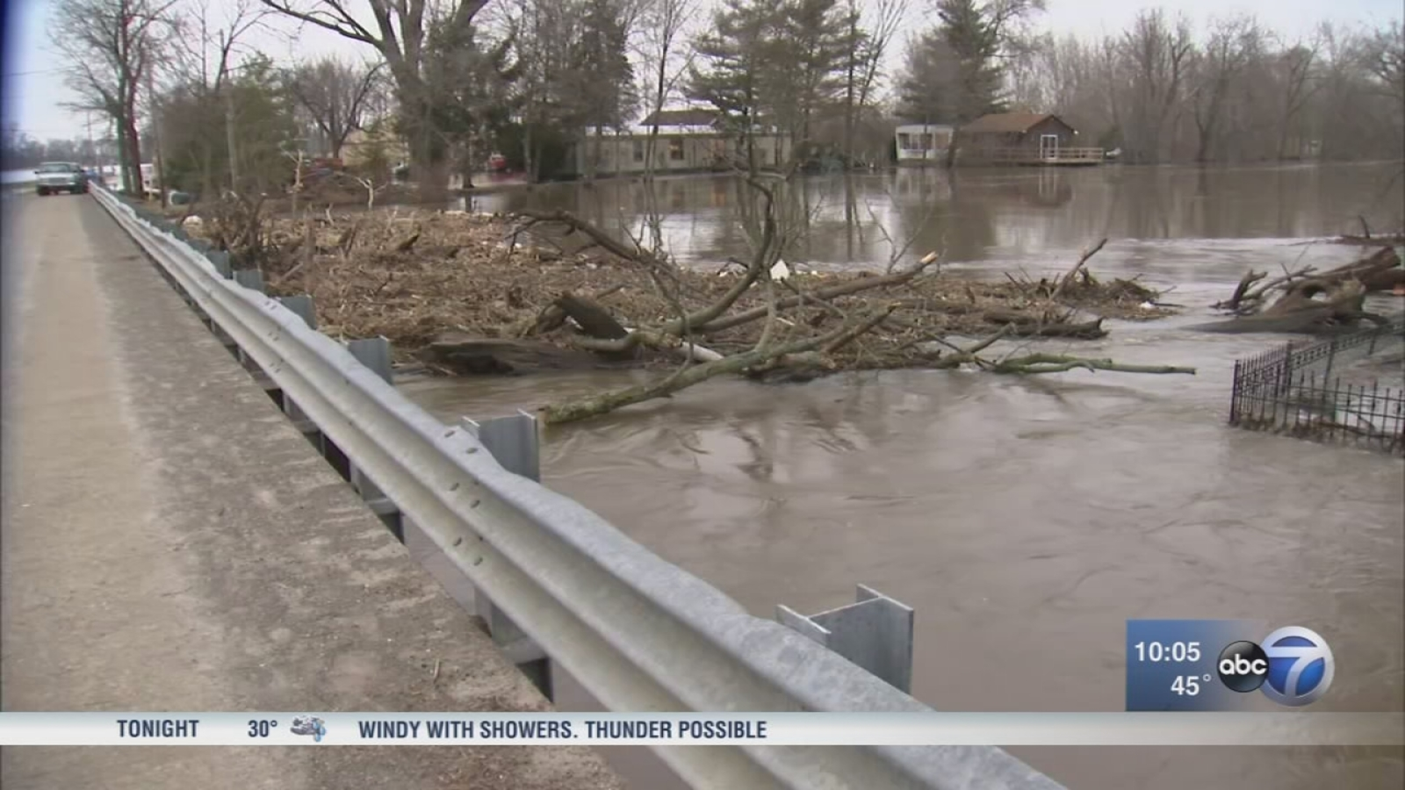
FLOOD IMAGES (2018)

Slide 15
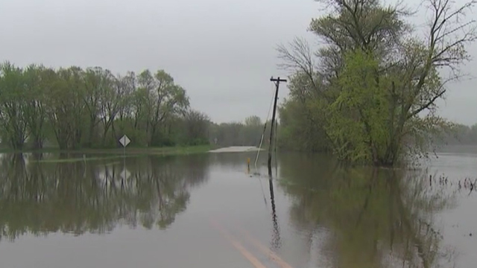
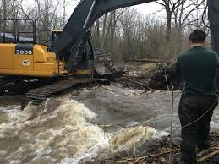
FLOOD IMAGES (2018)

Slide 16
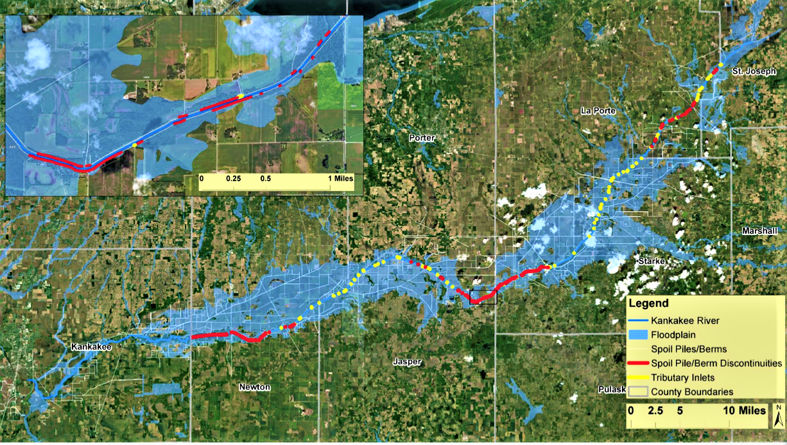
Kankakee Floodplains

Slide 17
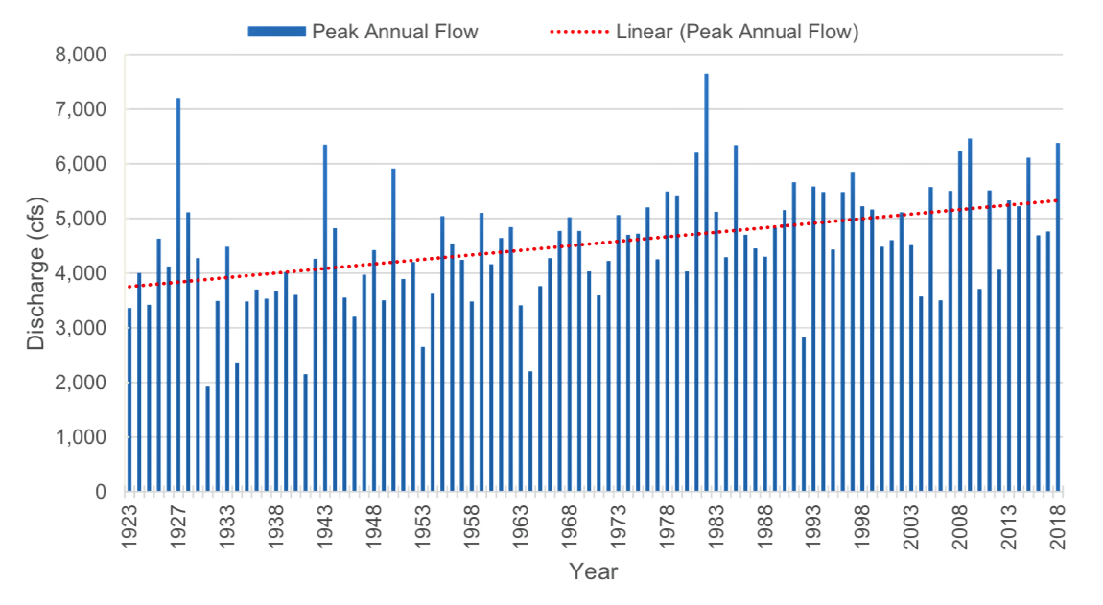
MORE WATER IN THE SYSTEM
SHELBY GAGE

Slide 18
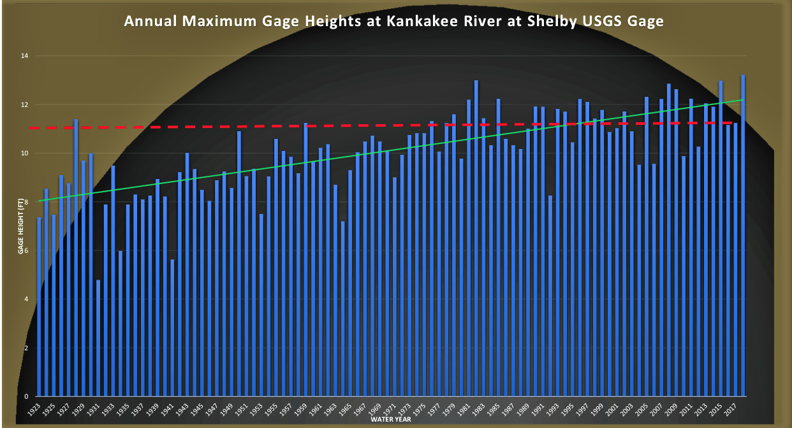
THE RIVER IS RISING
RED IS MODERATE FLOOD STAGE

Slide 19
THE DILEMMAS
More water in the system
More water leads to more erosion
Erosion makes it harder to contain the water

Slide 20
WHAT CONTRIBUTES WATER TO RIVERS?
Rain
Snowmelt
Drainage ditches
Field runoff
Runoff from paved roads, parking lots, and driveways
Wastewater from homes and businesses

Slide 21
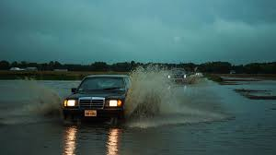
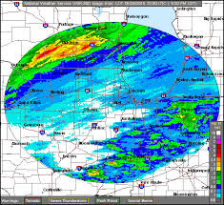
RAIN

Slide 22
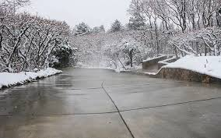
SNOWMELT

Slide 23
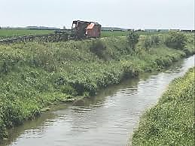
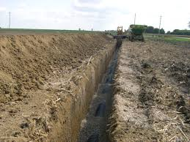
DRAINAGE DITCHES

Slide 24
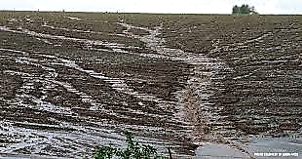
FIELD RUNOFF

Slide 25
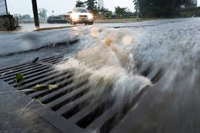
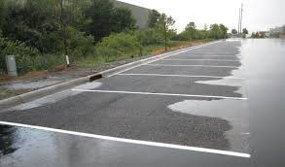
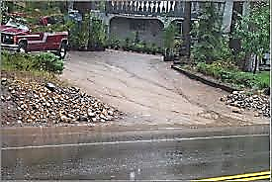
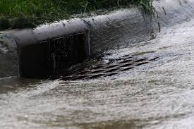
ASPHALT RUNOFF

Slide 26
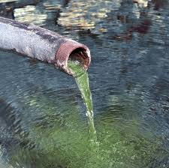
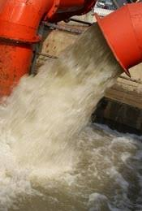
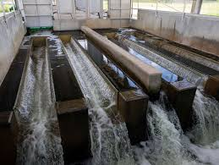
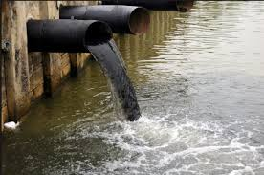
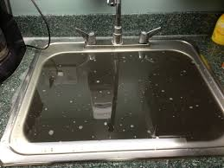
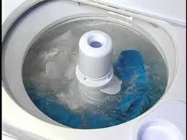
WASTEWATER

Slide 27
MORE WATER AND MORE SAND LEAD TO:
More frequent flood emergencies
Heightened threats to residential properties
Disruption of agricultural economy
Costly emergency responses and degraded tax bases
Degraded water quality and human environment

Slide 28
A TRIP DOWN THE KANKAKEE AND YELLOW RIVERS

Slide 29
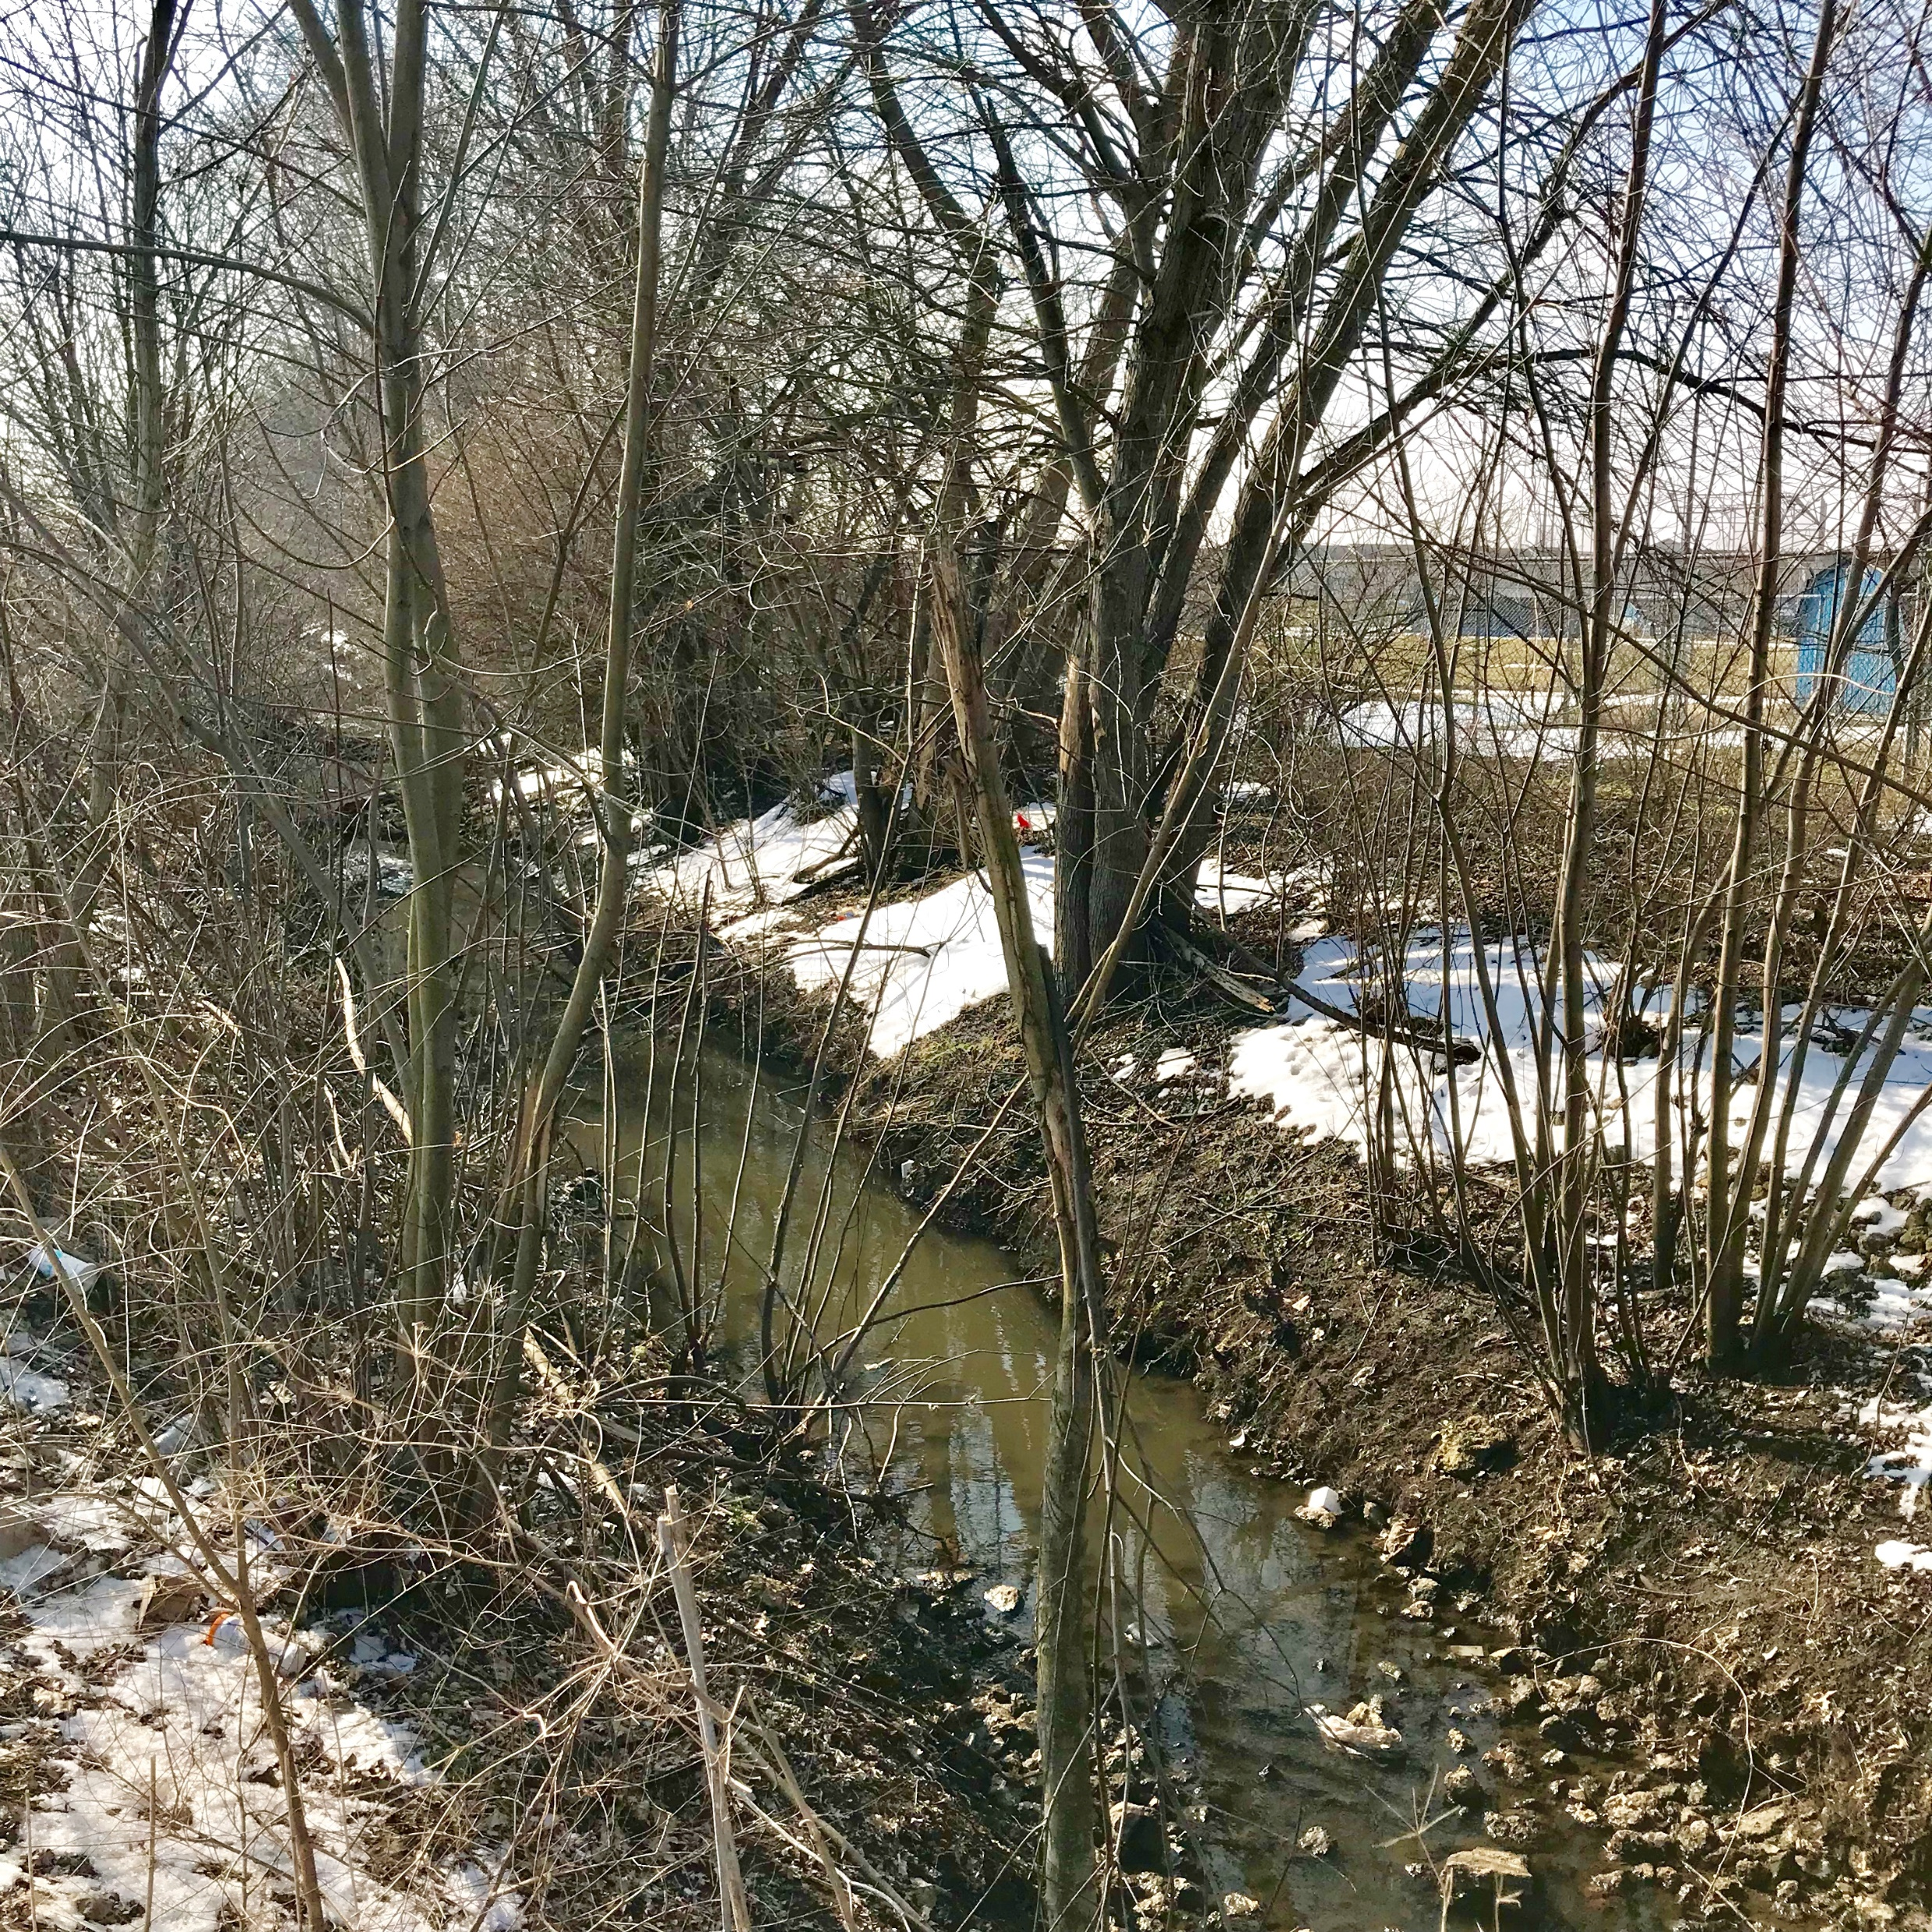
Kankakee Headwaters

Slide 30
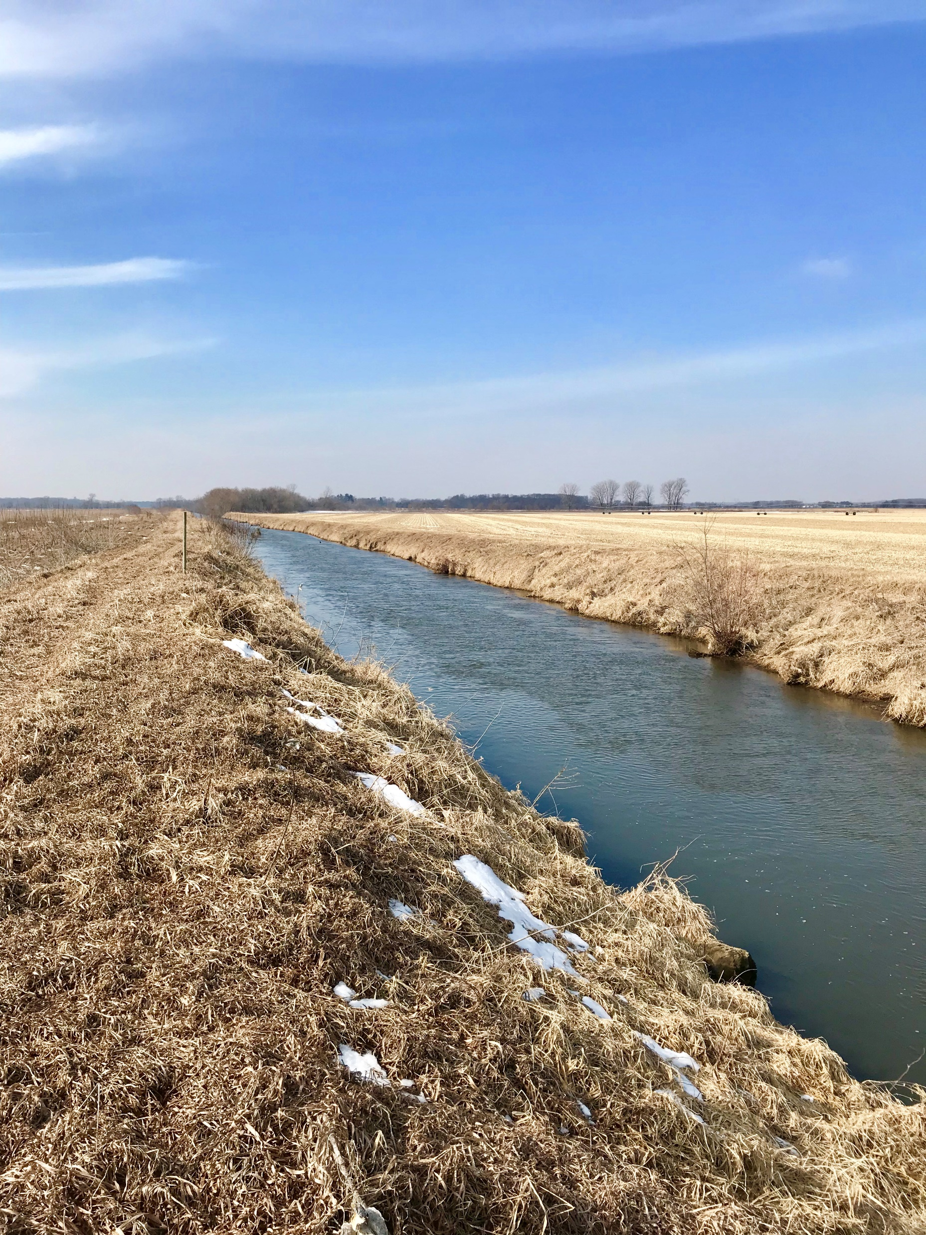
Modest Beginnings

Slide 31
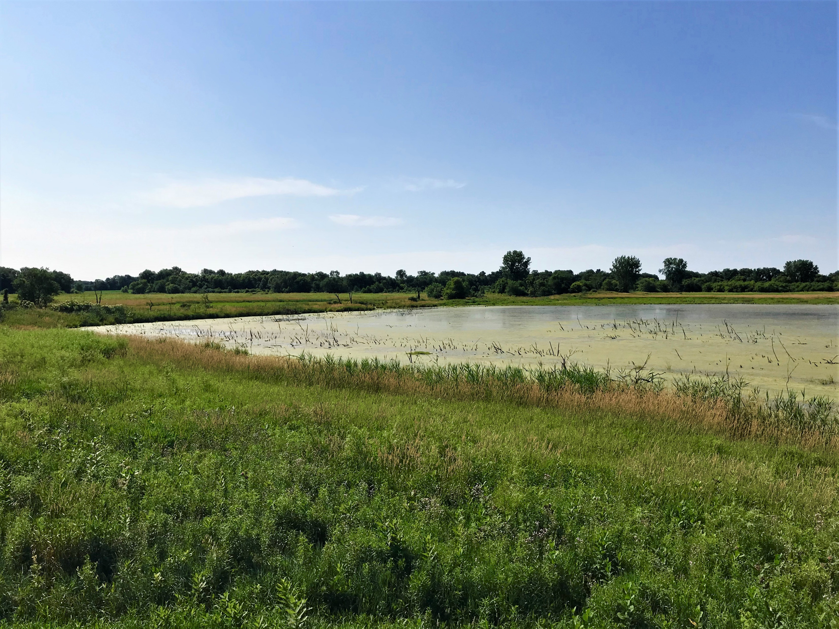
Pokagon Band Property

Slide 32

Marsh Remnants

Slide 33

Returning Marsh Behaviors

Slide 34

Original Meanders Visible

Slide 35

Heavier Sediment in Main Channel

Slide 36


WATER STORAGE NOT PLANNED

Slide 37


BANK PROBLEMS ARISE

Slide 38

Yellow River

Slide 39

Severe Yellow River Erosion

Slide 40

Sand Dunes Form Yellow River Banks

Slide 41

Yellow River Current Along Banks

Slide 42

Drainage Adds Sediment

Slide 43

Heavy Sediment Loads

Slide 44

Problem Trees Inaccessible

Slide 45

Sediment from Yellow Enters Kankakee

Slide 46

Human Barriers

Slide 47

Sediment and Bank Failures Worsen

Slide 48

Sediment Continues to Enter Downstream

Slide 49

Bank Failures Continue

Slide 50

High Bank Grades Contribute to Erosion

Slide 51

WATER BREAKS THROUGH BANKS
Rip-rap plugs major bank breach in Jasper County

Slide 52

TOUGH MEANS TO REINFORCE BANKS

Slide 53

CONTINUING BANK FAILURES

Slide 54

Lake and Newton Counties

Slide 55

More Human Barriers

Slide 56

Ice Impacts

Slide 57

Downstream

Slide 58

LaSalle Fish and Wildlife Area

Slide 59

“The Indiana Trash Collector”

Slide 60
LIVING IN THE SOLUTION

Slide 61
Public Law 282 (2019)
Creates 9-member Kankakee River Basin and Yellow River Basin Development Commission
Dedicates resources to long-term and root-cause solutions to problems along the Kankakee and Yellow Rivers
Indiana Department of Natural Resources (DNR) and Jasper, Lake, LaPorte, Marshal, Newton, Porter, Starke, and St. Joseph Counties represented

Slide 62
Public Law 282 (cont.)
Commission’s powers include:
  Bank stabilization
  Channel reconstruction
  Acquisition of land for flood storage
  Construction of levies
  Sediment removal and sand traps
  Tree removal and construction of access roads

Slide 63
Public Law 282 (cont.)
Approximately $3 million per year is derived from annual assessments on parcels within the basin:
  $1 per farm acre
  $7 per residential parcel
  $50 per commercial parcel
  $360 per utility or industrial parcel
  Counties may supplant or offset the assessments with other funds.

Slide 64
Public Law 282 (cont.)
Regulating agencies (DNR, IDEM) are directed to coordinate and streamline permitting
Preferences for Indiana workers and contractors on Commission projects
Commission maintains the 75-foot easement on the Kankakee and Yellow River channels only; counties retain full rights for emergencies
NO eminent domain powers

Slide 65
QUALIFICATIONS OF MEMBERS
Commission members are required to be experienced in one of the following:
  Construction
  Project management
  Flood control
  Drainage
  Another similar professional background
  The meanings of these terms are undefined in the statute.

Slide 66
OPTIONS FOR COUNTIES

Slide 67
OPTION #1: DO NOTHING
Assessments go in place by operation of law on May 2021 bills
A county simply collects and remits funds through regular procedures
Likely course of several counties

Slide 68
OPTION #2: PAY WITH OTHER FUNDS
County council can appropriate amounts equal to 90% of what the assessments would have raised
At least one county considering this option
Assessments would not take effect

Slide 69
OPTION #3: MIXED FUNDING
County councils can appropriate some of their own money and adopt a reduced fee schedule
Requires a vote
After 2023, counties choosing this option can retain 10% of the fee revenue to use away from the channel
Counties have the remainder or 2019 and all of 2020 to consider this option

Slide 70
OPTION #4: ADOPT HIGHER FEES
A county council can adopt a fee schedule that is higher than the state fee schedule
The county retains the difference between the two schedules
The county retains an additional 10% beyond the difference

Slide 71
MISSION
The Kankakee River Basin and Yellow River Basin Development Commission advances Northwest Indiana’s safety, economic prosperity, and quality of its natural resources.

Slide 72
VISION
The Kankakee River Basin and Yellow River Basin Development Commission is building a region where its residents, farms, and communities prosper in concert with one of the nation’s most unique natural environments.

Slide 73

ENGINEERING PLAN RECOMMENDATIONS

Slide 74
COMPLETED YELLOW RIVER PILOT PROJECT
Paths forward…

Slide 75

BANK STABILIZATION AND EROSION CONTROL

Slide 76

YELLOW RIVER IN STARKE COUNTY SELECTED

Slide 77

TECHNIQUES DEMONSTRATED

Slide 78

SECTION OF YELLOW RIVER “BEFORE”

Slide 79

CONSTRUCTION

Slide 80

CONSTRUCTION COMPLETED

Slide 81

PILOT PROJECT DURING 2018 FLOOD

Slide 82

PILOT PROJECT, SUMMER 2018

Slide 83

PILOT PROJECT, WINTER 2019

Slide 84
RESULTS
Current located in center of channel
Current moved away from banks
Banks highly stabilized with native flora
Widened volume capacity

Slide 85
ADJACENT LAND COMPARISONS

Slide 86
LONG-TERM GOALS
Reduce sediment entering the river system
Stabilize banks
Create more storage for greater volumes of water
Protect vital economic assets
Reduce human-made barriers

Slide 87
PURSUED OUTCOMES
Safety and predictability for the region’s residents and businesses
Successful agricultural sector
Improved water quality
Development of both economic and natural resources

Slide 88
QUESTIONS?
Scott D. Pelath
(219) 861-7999
sdpelath@gmail.com

